Slide 1
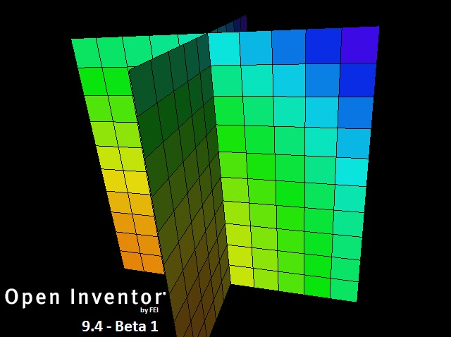
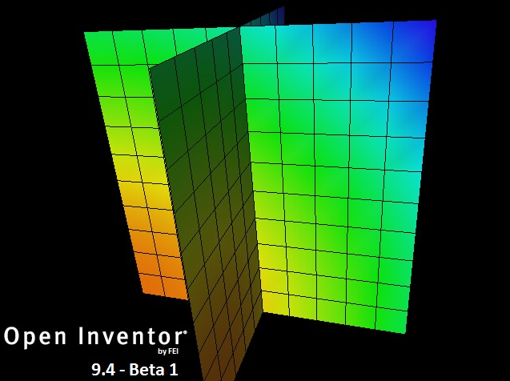
OIV Data Mapping
2 data mapping modes:
PER_CELL
PER_NODE

Slide 2
OIV Data Mapping
PER_CELL
Single value for entire cell
PER_NODE
Interpolated across cell
When multiple cells share the same node, they also share the same data value

Slide 3
OIV Data Mapping
Discontinuous property values PER_NODE
Requires node duplication
Affects rendering performance
Skin extraction depends on shared nodes
Less node sharing → more nodes to render
Layer 1
Layer 2

Slide 4
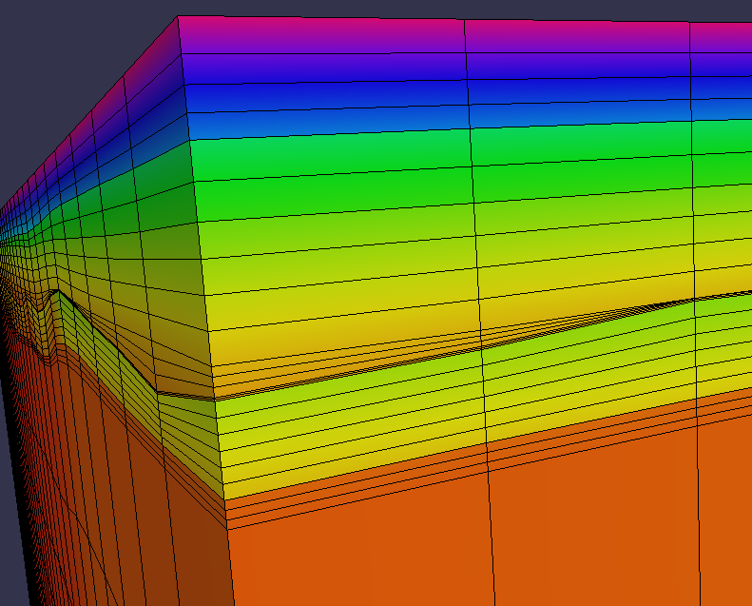
OIV Data Mapping
Current 4D prototype already displays discontinuities:
Coordinates duplicated on formation boundary

Slide 5
OIV Data Mapping
MeshViz XLM interface used by prototype:
“MiHexahedronTopologyExplicitIjk”
I, J, K hexahedron mesh
Specify 8 coordinate indices for each cell
So node sharing is completely within our control

